Slide 1
Marshall Islands
Globe Asia-Pacific Regional Meeting
Seoul, Republic of Korea
22-23 May 2019

Slide 2
Overview of the Presentation
GLOBE in the Marshall Islands
Priorities Goal areas for the Marshall Islands 2018-2022
Challenges
Way Forward

Slide 3
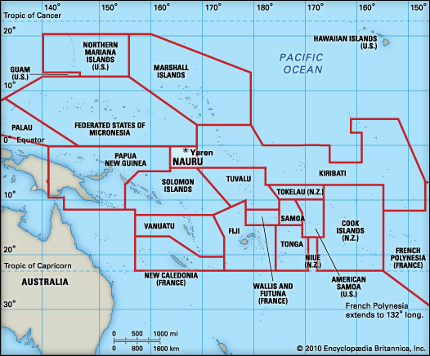

Slide 4
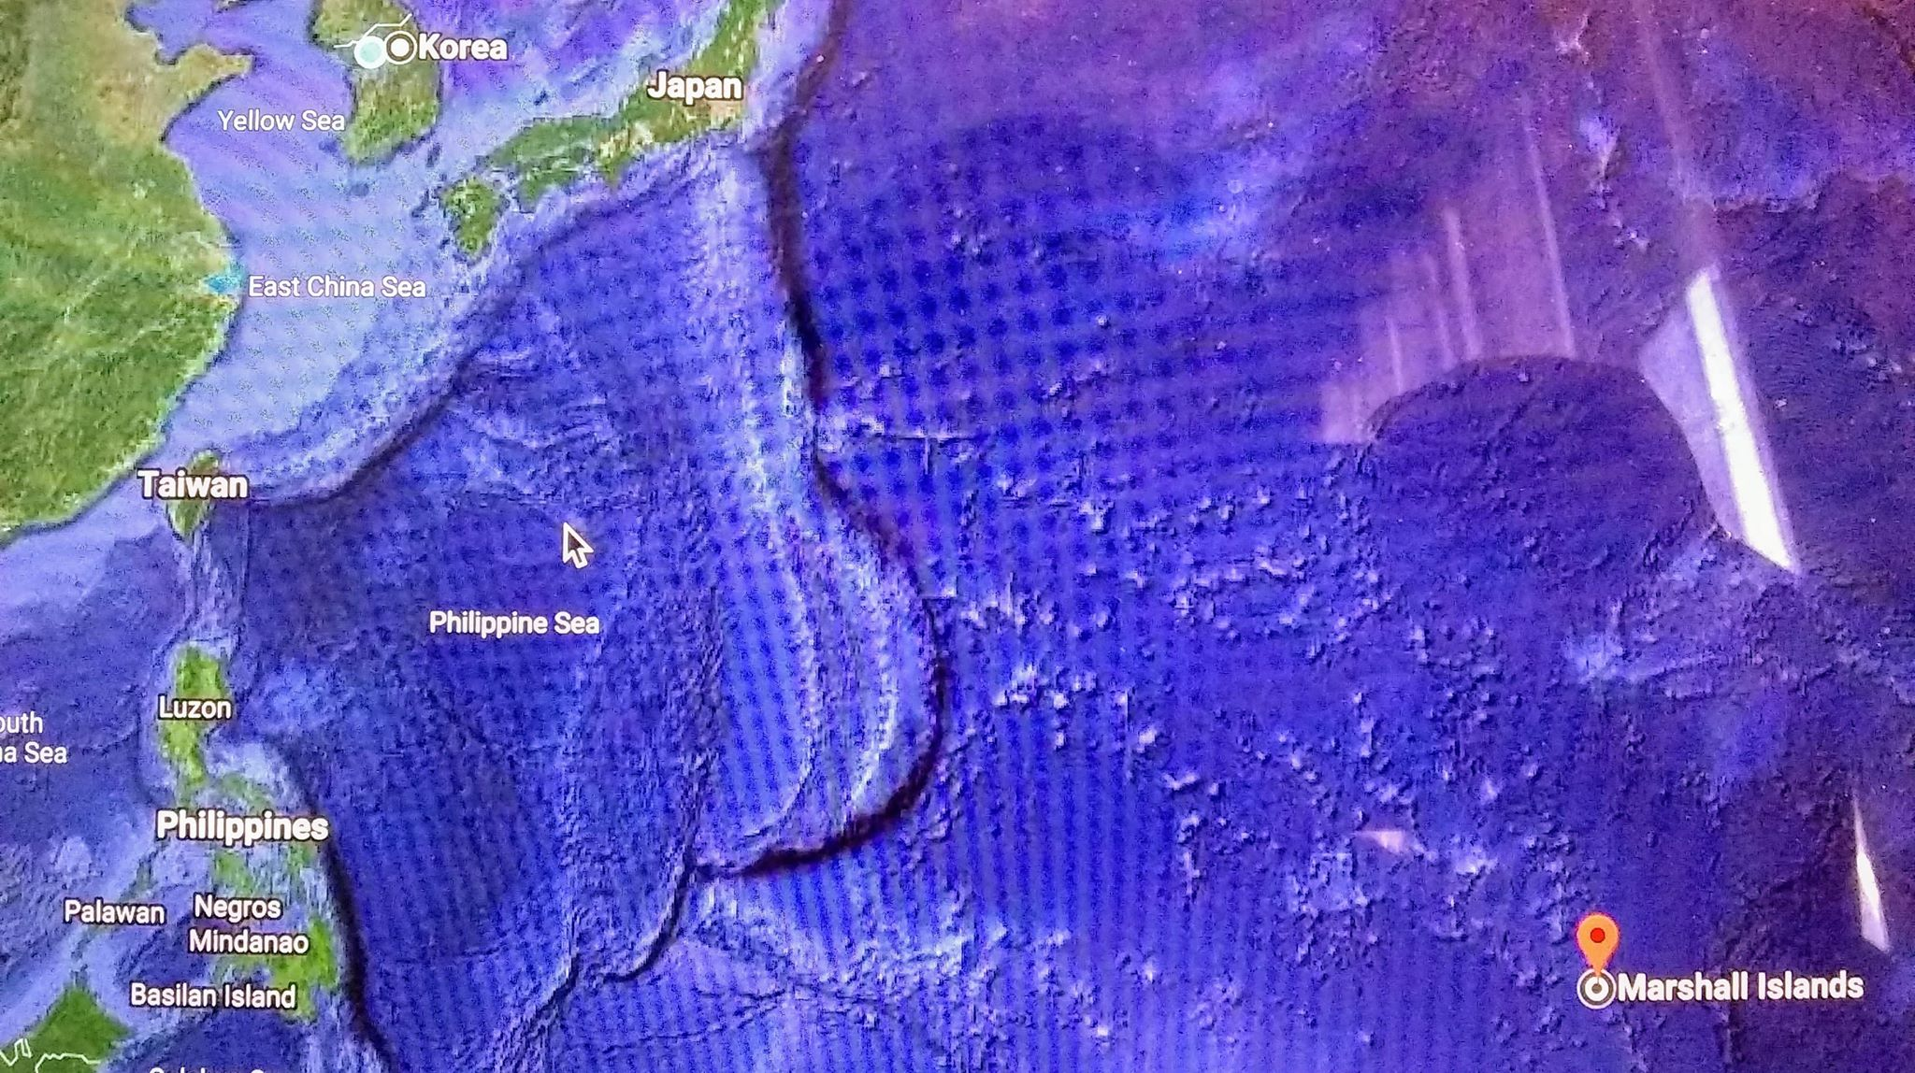

Slide 5
Globe in the Marshall Islands
Joined in 1996
5 GLOBE Schools
3 on Majuro, Majuro Atoll (Capital of Marshall Islands)
1 on Ebeye, Kwajalein Atoll (Ralik Chain)
1 on Wotje, Wotje Atoll (Ratak Chain)
1 in the process of become a GLOBE School in 2020
1 GLOBE Scientist

Slide 6
Globe in the Marshall Islands (con’t)
In 2018 there were no trained teachers
In 2019 we have 52 to fully trained GLOBE Teachers, 7 registered teachers but not trained and 10 trained Observers (Community Members – Health Officials and etc.) on the Mosquito Protocol
Three CMTs were carried out on two of the Jurisdictions in the Marshall Islands, on Majuro Atoll and Wotje Atoll
There was a plan to carry out a 4th one on Ebeye, Kwajalein Atoll but due to transportation, human resources, technical resources and timing, it did not happen

Slide 7
GLOBE in the Marshall Islands (Con’t)
CMT Workshop Items | Description | Amount
Venue | Community Center, Churches, Schools and Local Government | $600
Food | 4 trainings per year for 30 people | $1,000
Equipment | Projector, Projector Screen, Mosquito Devices | $450
Transportation | Wotje, Wodmej, 4 small islets | $950
Experts Introduction Training to Community | GLOBE Scientist – Travel to Islets | $2,000
TOTAL |  | $5,000

Slide 8
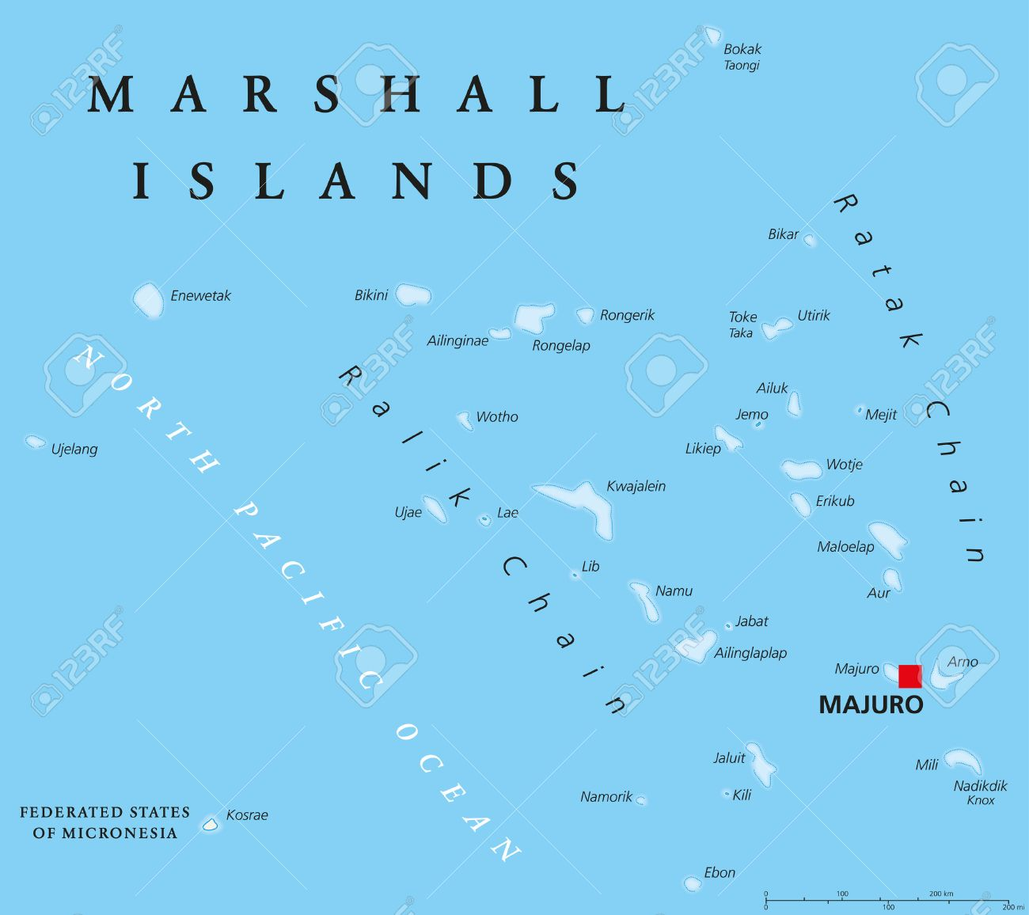

Slide 9
Priorities Goal areas for the Marshall Islands 2018-2022
Professional Development
EG2: GLOBE’s Capacity to deliver high quality professional learning experience (trainings) has increased
By the end of 2022, increase the number of GLOBE trained teachers in the Marshall Islands by 5%
2 workshops held for teachers annually in the Marshall Islands, one on the Ratak Chain and the other on the Ralik Chain or using the current Public School System
Student Investigation
EG3: Students develop high quality STEM investigations of the Earth system phenomena from a local to global scale perspective
By end of 2022, 2 students from the Marshall Islands

Slide 10
Challenges
Data uploading was an issue due to very weak internet on Wotje Atoll
Geographic Isolation
Limited human resources
Funding

Slide 11
Way Forward
Teachers to join exchange programs
Have more sub-region/regional cooperation
Improve the GLOBE Apps for uploading data
Identify funding for certain countries to tap into and GLOBE to assist with proposals
Attend more trainings for GLOBE and other related workshops
Government to buy a faster internet speed so that we can upload the data
Encourage students to major in science and hire more science teachers

Slide 12
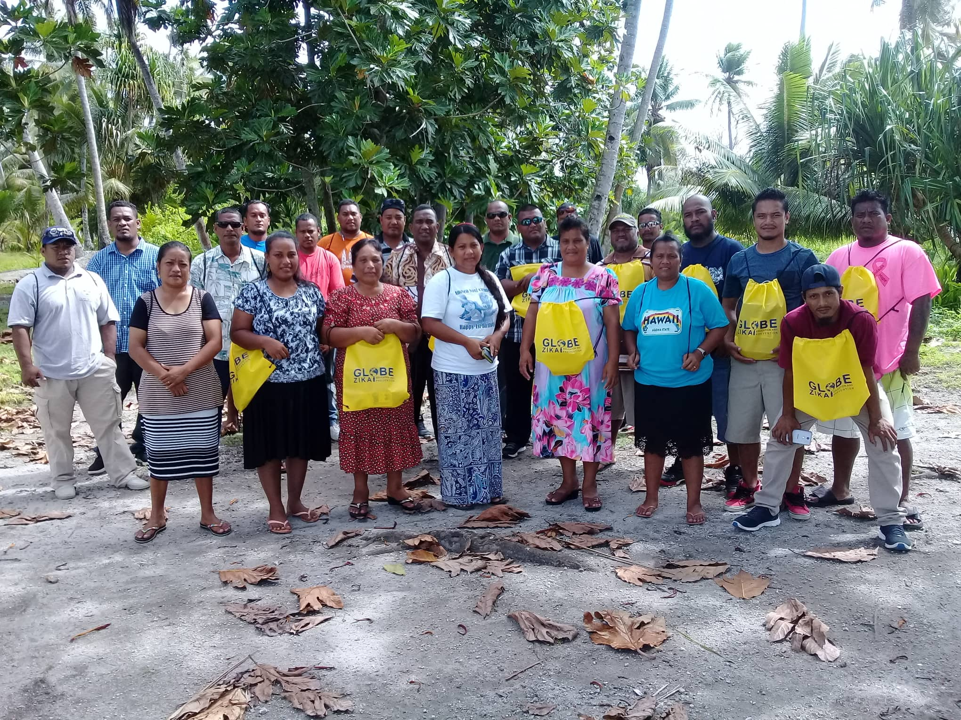
Komol tata

